Slide 1





Slide 2


Slide 3


Slide 4


Slide 5


Slide 6


Slide 7


Slide 8



Slide 9


Slide 10


Slide 11


Slide 12



Slide 13


Slide 14


Slide 15


Slide 16


Slide 17
Notes:
Add SQL like syntax

Slide 18



Slide 19



Slide 20



Slide 21



Slide 22



Slide 23



Slide 24



Slide 25


Slide 26


Slide 27


Slide 28


Slide 29


Slide 30

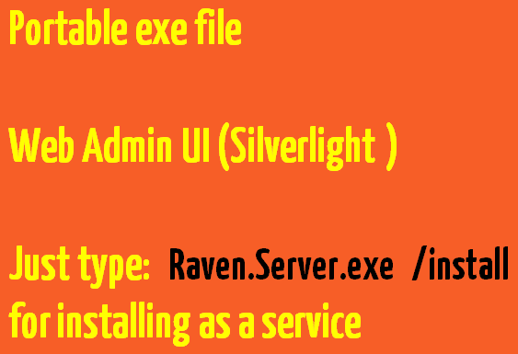

Slide 31


Slide 32


Slide 33


Slide 34


Slide 35


Slide 36


Slide 37


Slide 38


Slide 39


Slide 40

Notes:
Change the background color…

Slide 41

Notes:
Change the background color…

Slide 42

Notes:
Change the background color…

Slide 43

Notes:
Change the background color…

Slide 44

Notes:
Change the background color…

Slide 45

Notes:
Change the background color…

Slide 46

Notes:
Change the background color…

Slide 47

Notes:
Change the background color…

Slide 48

Notes:
Change the background color…

Slide 49

Notes:
Change the background color…

Slide 50

Notes:
Change the background color…

Slide 51

Notes:
Change the background color…

Slide 52

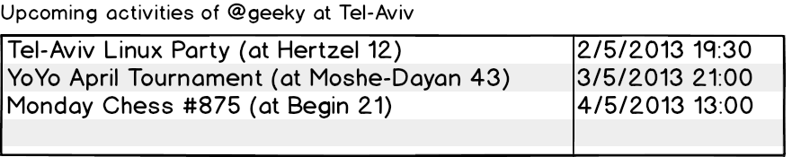
Notes:
Change the background color…

Slide 53

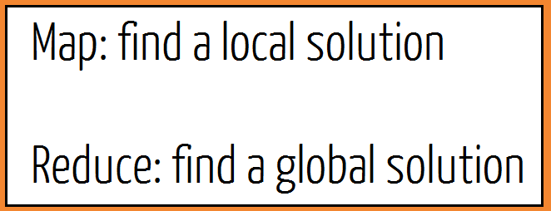
Notes:
Change the background color…

Slide 54

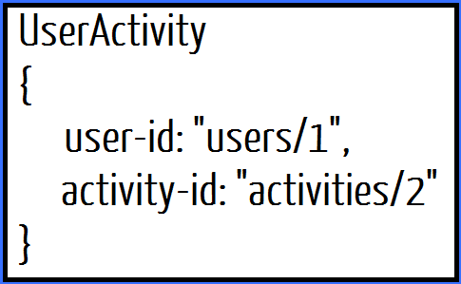
Notes:
Change the background color…

Slide 55
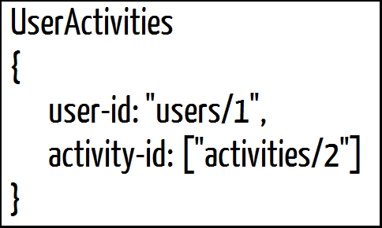
Notes:
Change the background color…

Slide 56

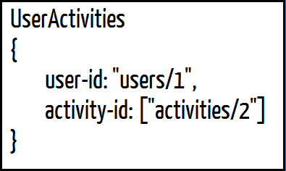
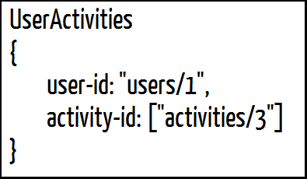
Notes:
Change the background color…

Slide 57
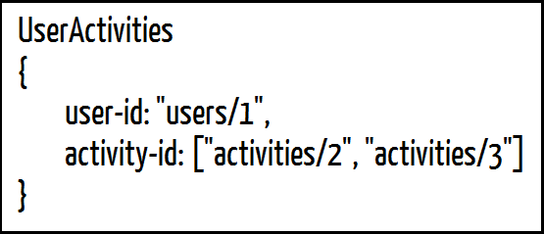
Notes:
Change the background color…

Slide 58

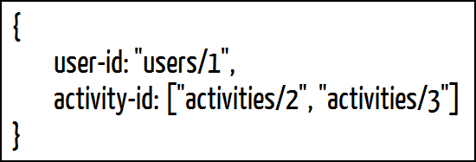
Notes:
Change the background color…

Slide 59
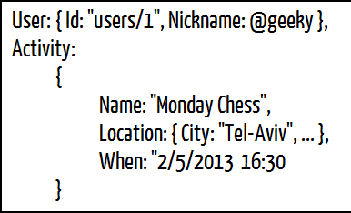
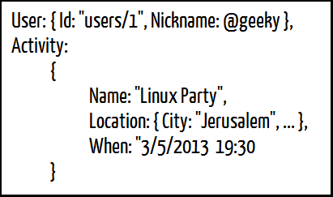
Notes:
Change the background color…

Slide 60

Notes:
Change the background color…

Slide 61

Notes:
Change the background color…

Slide 62

Notes:
Change the background color…

Slide 63

Notes:
Change the background color…

Slide 64

Notes:
Change the background color…

Slide 65

Notes:
Change the background color…

Slide 66


Slide 67

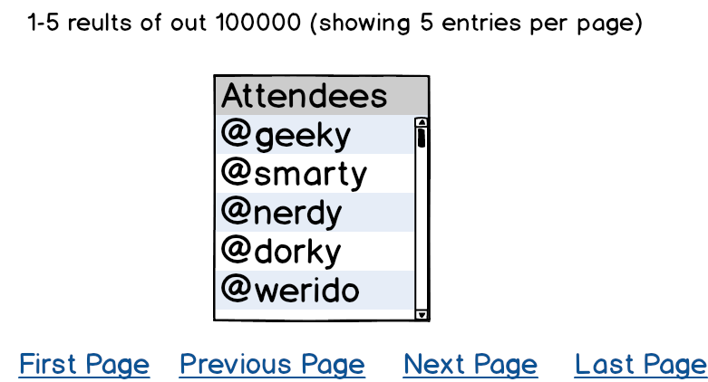

Slide 68
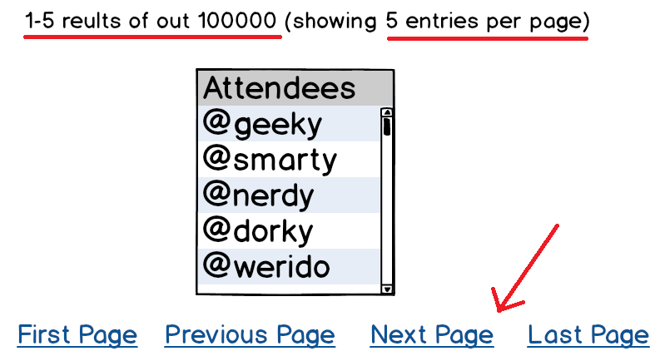

Slide 69


Slide 70


Slide 71


Slide 72



Slide 73
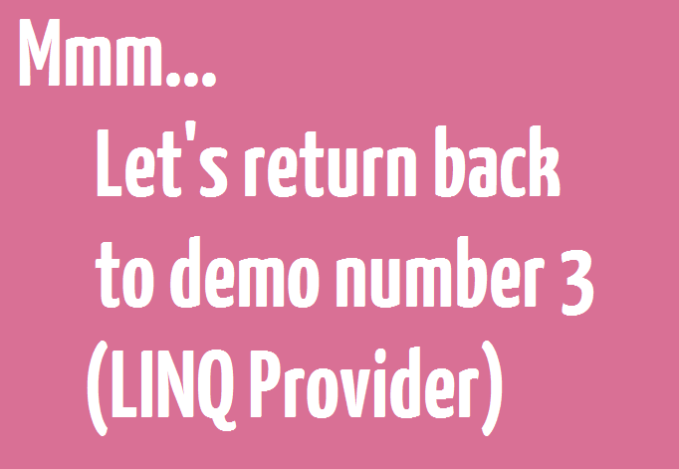

Slide 74


Slide 75

Notes:
Add spaces
Add links for the download

Slide 76

Notes:
Add spaces
Add links for the download

Slide 77

Notes:
Add spaces
Add links for the download

Slide 78

Notes:
Add spaces
Add links for the download

Slide 79

Notes:
Add spaces
Add links for the download

Slide 80

Notes:
Add spaces
Add links for the download

Slide 81

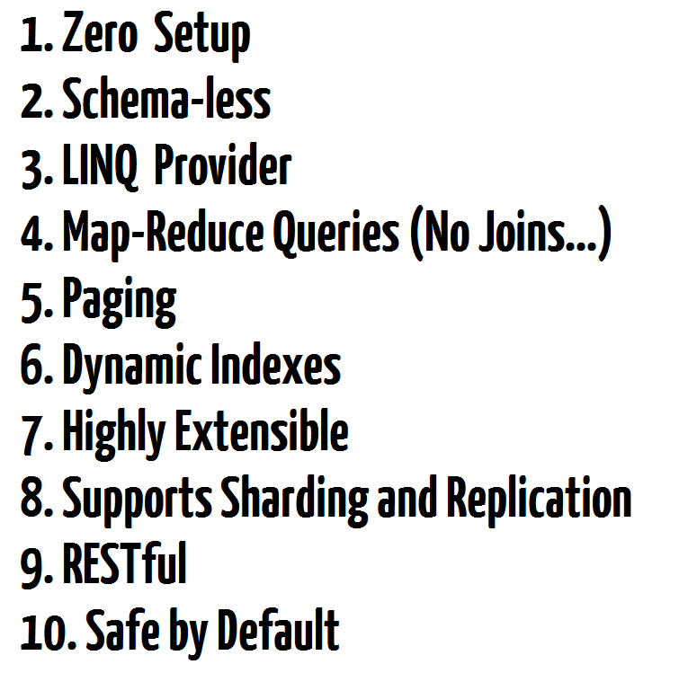

Notes:
Add spaces
Add links for the download

Slide 82
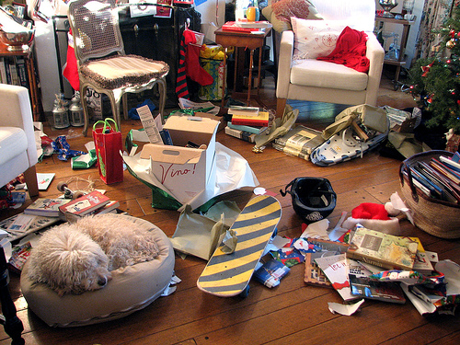
Notes:
Add spaces
Add links for the download

Slide 83


Notes:
Add spaces
Add links for the download

Slide 84

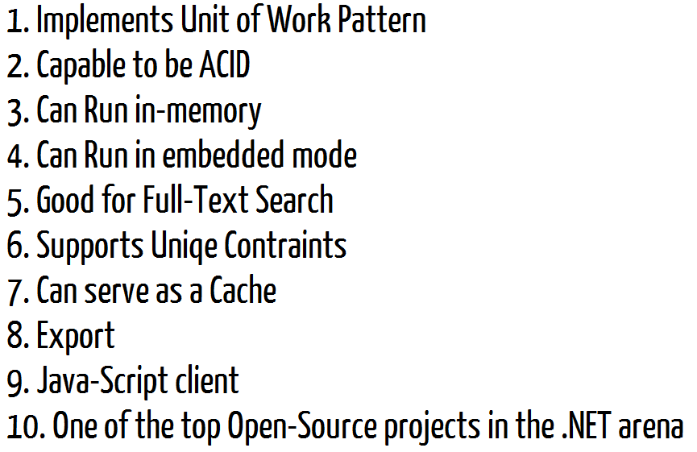
Notes:
Add spaces
Add links for the download

Slide 85


Slide 86




Notes:
Add spaces
Add links for the download

Slide 87


